Slide 1
Fundamentals of testing

Slide 2

Today’s menu:
What is testing?
Why is testing important?
Basic principles of testing
Process of testing
Psychology of testing
Ethics of testing

Slide 3

What is testing?
A static or dynamic process, connected to all phases of the software development lifecycle that’s related to designing, implementing and evaluating a software, in order to determine if the software meets the requirements, accomplishes its goals. Testing is responsible for finding errors.

Slide 4


A Bug Story
Harvard Mark II
Moth found behind panel F relay 70

Slide 5


Why is testing important?

Slide 6

Ariane 5
The story: The Ariane 5 rocket was destroyed seconds after launch. Its cargo was also lost: 4 satellites designed to measure the interaction between solar wind and Earth’s magnetic field.
The cause: The rocket’s control unit simply turned off after trying to convert velocity data from 64 bits to 16 bits. After the overflow, the secondary control unit took over, and immediately stopped as well, because it was using the same algorithm.
The cost: 500 million $

Slide 7

Mars Climate Orbiter
The story: The Mars Climate Orbiter burned up after entering the planet’s atmosphere too close to the surface, thanks to a navigation error. The survive, it should have stayed 85 kilometers away, instead it came 60 kilometers from the surface.
The cause: Lockheed Martin Astronautics used imperial units when giving acceleration data instead of metric units. The data was interpreted by a computer that only knew metric, thinking the data it received was using metric units. Previously, this error only had a very small effect that remained unnoticed. After months of travel, the errors accumulated. Before the incident, the orbiter traveled 669 million kilometers in 9 and a half months.
The cost: 125 million $

Slide 8

Principles of testing
Testing shows presence of defects
Exhaustive testing is not possible
Early testing
Defect clustering
Pesticide paradox
Testing is context dependent
Absence of errors fallacy

Slide 9

Testing shows the presence of defects
Testing shows presence of defects, but can’t prove their absence. Testing reduces the chanche of software having unknown errors, but not finding errors is not proof of the system being perfect.
Just because you can’t see it, doesn’t mean it isn’t there.

Slide 10
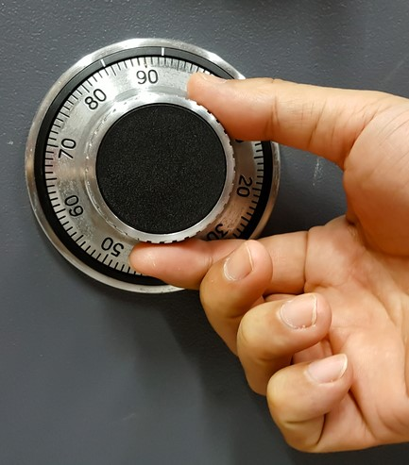
Exhaustive testing is not possible
Exhaustive testing, i.e. testing every combination of input and preconditions – aside from trivial cases – is not possible. Instead of exhaustive testing, we need to use risk assessment and priorities to make testing more focused and efficient.
For example, given 15 fields that can take 5 different values each, the number of combinations to test would be 5^15, or 30 517 578 125.

Slide 11
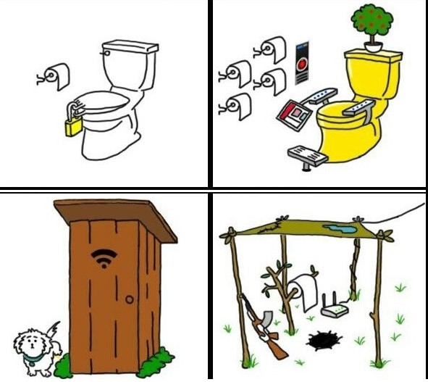
Early testing
Testing should begin at the earliest possible stage of the software development lifecycle, and it needs to concentrate on the established requirements.

Slide 12

Defect clustering
Experience shows that errors usually cluster to certain parts of the code/module. This can be bacause this part of the system is significantly more complex, or it can be an integration point where multiple subsystems meet, and errors arise from their interactions.

Slide 13

Pesticide paradox
Repeating the same tests will not find new bugs after a certain time. The bugs become immune to the tests. For this reason, the tests need to be constantly reviewed and updated, so we can test different parts of the system and find new bugs.

Slide 14
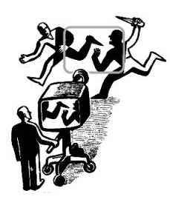
Testing is context dependent
Which parts of the system are tested more depends on the goals of the system. A system where security is critical, like a bank system, needs to be tested differently than a webshop.

Slide 15

Absence of errors fallacy
Finding and fixing errors is meaningless if the system is useless and doesn’t fit the requirements of the client.

Slide 16

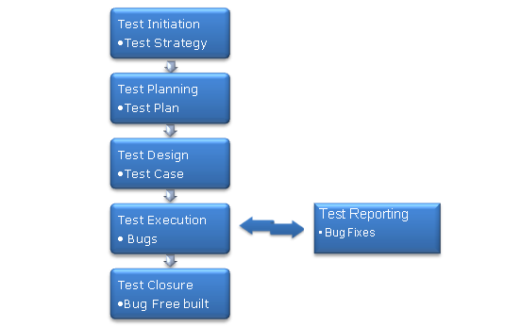
Process of testing

Slide 17

Psychology of testing
Neutrality, objectivity, factuality
Don’t blame others
Constructive criticism
Positive feedback is also necessary
Be helpful and cooperative
Make sure everything is understood the same way
Take care of people’s emotions

Slide 18

Ethics of testing
Testers often have access to sensitive or protected data
Proper security must be used
Data and documents must be handled in a secure way

Slide 19
Thank you for your attention!

